Slide 1

HealthSense AI
Precision Clinical Intelligence
Predictive Diagnostics
7-Day Wellness Plans
Longitudinal Tracking
AI Chatbot
Iqra (24K-1024) Fabiha Siddiqui (24K-1022) Syeda Maha Fatima(24K-0624)

Slide 2

Project Overview
What is HealthSense AI?
5+
1,000
A full-stack, AI-driven health management system that bridges raw clinical telemetry and meaningful patient insight — all in one unified dashboard.
AI Techniques
Patient Records
Core Capabilities
ML · Genetic Algorithm ·
NLP
Synthetic dataset
Predicts Anaemia, Diabetes & Cardiovascular Disease from biomarkers
Generates personalised 7-day wellness protocols via Genetic Algorithm
Plots longitudinal health trajectories with AI trendlines
Integrated NLP chatbot restricted strictly to clinical queries
Modular Python backend paired with a modern, aesthetic web dashboard
4
8
Disease Classes
Biomarker Features
Diabetes · Heart · Anaemia · Healthy
Glucose · BP · Cholesterol · more
HealthSense AI · FAST NUCES Karachi · BCS-4J · AI-2002

Slide 3
Problem Statement & Objectives
The Problem
Objectives Achieved
Patients struggle to interpret raw lab reports without expert guidance
No immediate post-diagnosis lifestyle recommendations available
Difficult to visualise whether health is improving or worsening over time
Traditional clinical software uses rigid rule-based logic that misses complex biomarker relationships
Preventive care is often neglected until conditions become severe
Predictive Diagnostics: Train ML classifiers on 8 biomarkers to predict 4 disease classes
Patient Tracking: Mathematical modelling to forecast biomarker trends over time
Algorithmic Optimisation: Genetic Algorithm evolves an optimal 7-day diet & exercise plan
AI Chatbot: NLP assistant (Llama-3.1) restricted exclusively to medical queries
Full-Stack Platform: Modular Python backend + responsive web dashboard
HealthSense AI · FAST NUCES Karachi · BCS-4J · AI-2002

Slide 4
Core AI Techniques
Linear Regression
Random Forest
Gaussian Naïve Bayes
Trend Prediction
Ensemble Classification
Probabilistic Inference
Fits y = mx + c to historical biomarker readings. Visualised as live Chart.js trendlines so patients see whether glucose or cholesterol is rising or falling.
Primary diagnostic engine — 200 trees, max depth 10. Resistant to overfitting; delivers the final 4-class disease classification with high accuracy.
Returns percentage-based risk breakdowns (e.g. 85% Diabetes) using Bayes' Theorem with Gaussian distribution for continuous clinical variables.
Genetic Algorithm
Llama-3.1 (Groq API)
StandardScaler + Imputation
Evolutionary Search
Generative NLP
Data Preprocessing
50 generations × 20 chromosomes. Elitism + Crossover + 10% Mutation evolves the mathematically optimal 7-day meal & exercise protocol in 1–2 seconds.
Transformer-based chatbot with engineered system prompt that enforces absolute domain restriction — declines any non-medical query automatically.
Median Imputation fills missing values; StandardScaler normalises all features to µ=0, σ=1 so high-magnitude variables (Cholesterol) don't dominate training.
HealthSense AI · FAST NUCES Karachi · BCS-4J · AI-2002

Slide 5
System Architecture
app.py
utils.py
Application Core
Helper Library
Flask server · API routing · user auth · Linear Regression · Groq Llama-3.1 NLP integration
HEALTHY_RANGES constants · disease-to-recommendation mapping · CSV/TXT report parser
synthetic_generator.py
data_prep.py
Data Engineering
Preprocessing
Generates 1,000 realistic patient records via Gaussian distributions (np.random.normal) across 4 classes
Data cleaning · Median Imputation · LabelEncoder · StandardScaler normalisation
train_model.py
genetic_planner.py
Model Training
Search Agent
Trains & serialises Gaussian Naïve Bayes and Random Forest classifiers as .pkl artifacts
TreatmentGeneticAlgorithm — fitness evaluation, crossover, 10% mutation, elitism over 50 generations
HealthSense AI · FAST NUCES Karachi · BCS-4J · AI-2002

Slide 6
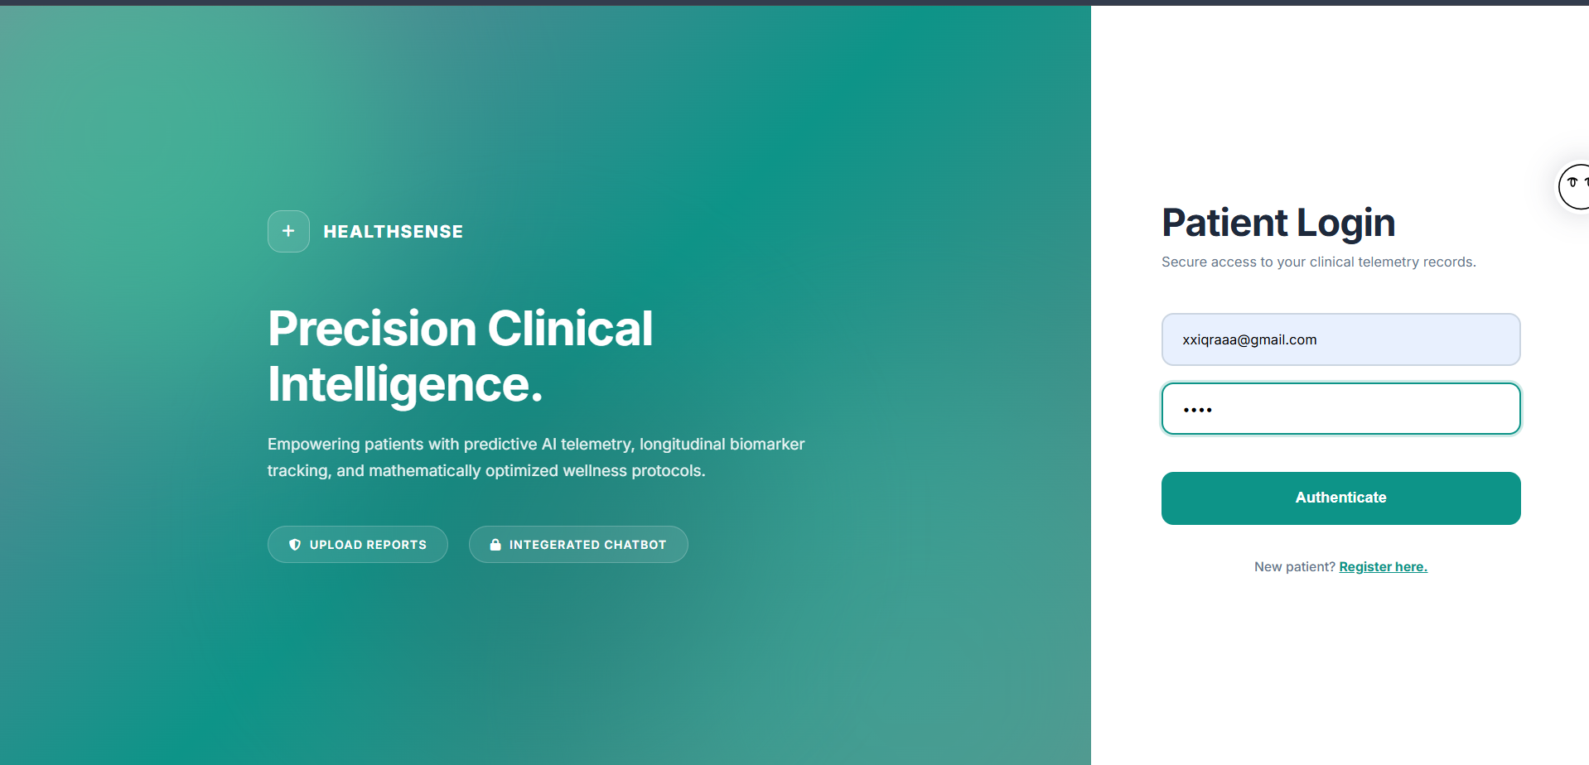
Webpage Screenshots
Splash Screen
Either Register or Login with existing account!

Slide 7
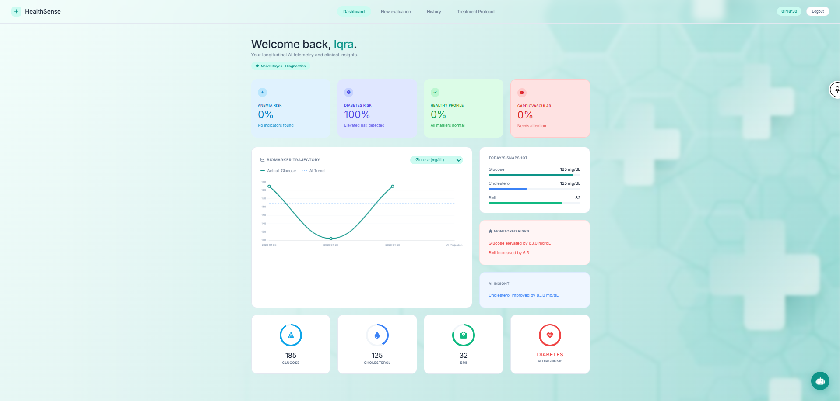
Webpage Screenshots
Dashboard
Backend: Python 3..13, Flask, NumPy, Pandas, Scikit learn
Frontend: HTML, CSS, JavaScript, Chart.js
Data Storage: JSON Files
New Evaluation allows you to generate report.
You can view history, your 7-day care plan after report generation

Slide 8
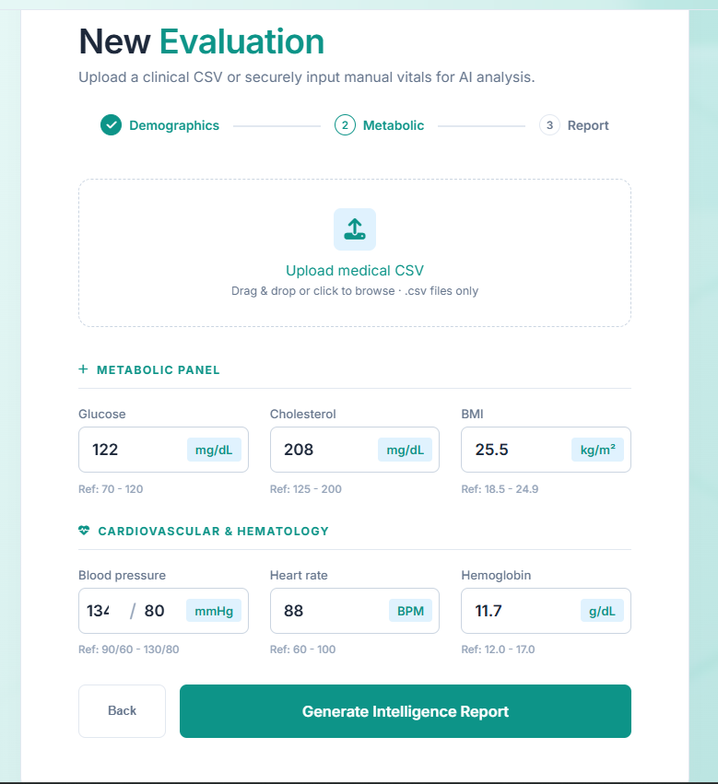
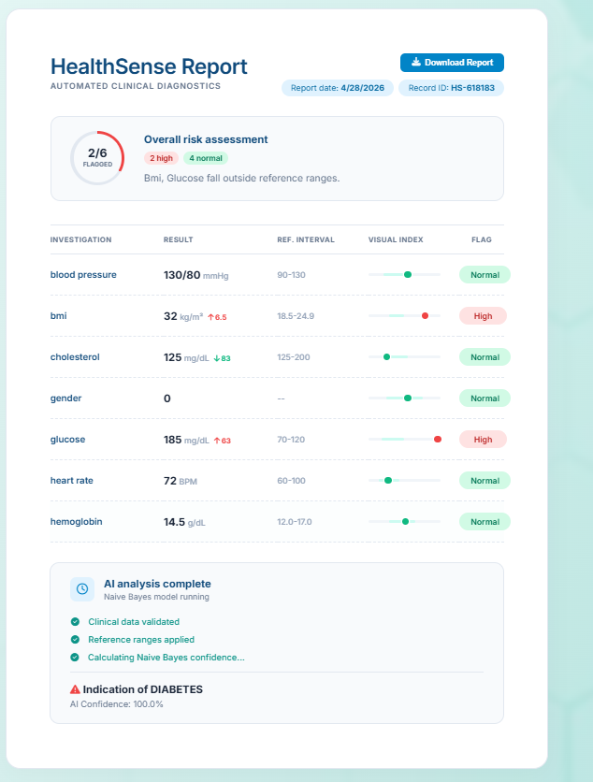
Webpage Screenshots
Evaluation & Report Generation
Either Upload CSV File or Enter Manually

Slide 9
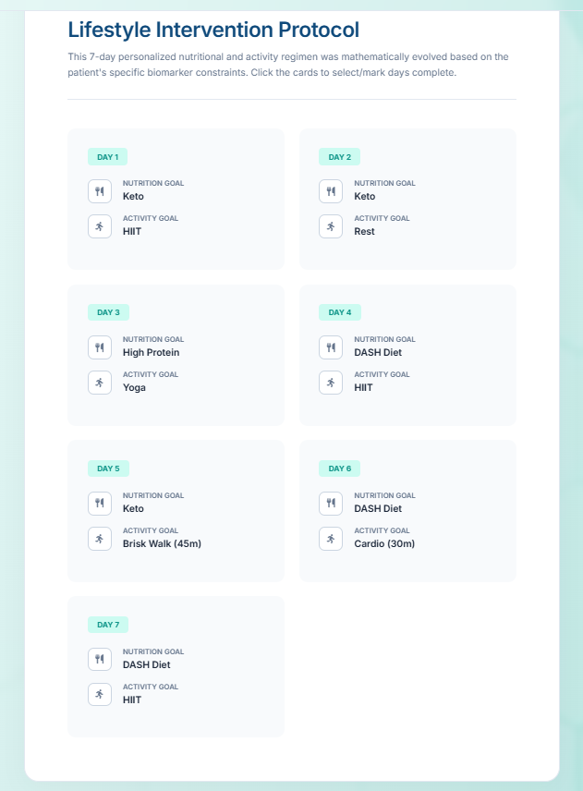
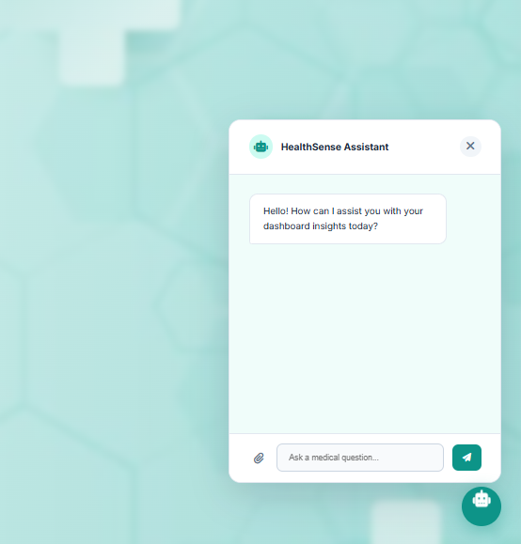
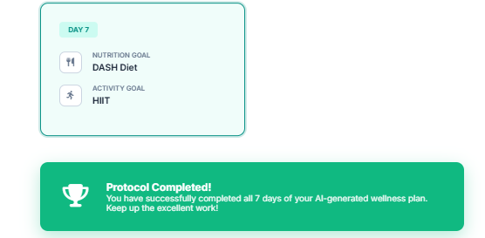
Webpage Screenshots
Careplan & Chatbot
Domain Restricted
Integrated Chat Bot
You can mark the cards and once all of them are completed, you earn completion protocol.

Slide 10
Dataset & Model Results
Dataset Overview (data.csv)
Model Performance Highlights
Property | Value
Total Records | 1,000 patient entries
Feature Count | 9 (8 input + 1 label)
Target Classes | 4 (Diabetes · Heart · Anaemia · Healthy)
File Format | CSV (Comma-Separated Values)
Source | Curated synthetic clinical data
Train / Test Split | 80% training / 20% testing
Random Forest Classifier
Exceptional accuracy across all 4 disease classes
Minimal false positives for severe conditions
200 estimators, max depth 10 — robust to overfitting
Genetic Algorithm
Converges on optimal lifestyle plan in 1–2 seconds
50 generations × 20 chromosomes per run
Test: Hyperglycemia → correctly assigned DASH & Keto
NLP Domain Restriction
LLM correctly rejects all non-medical queries
System prompt engineering enforces clinical scope
HealthSense AI · FAST NUCES Karachi · BCS-4J · AI-2002

Slide 11
Applications & Future Work
1
2
3
Clinical Triage
Education & Research
Personal Wellness (SaaS)
Deploy in clinic waiting rooms — patients input vitals on a tablet, giving doctors an immediate probabilistic health risk breakdown before consultation.
Practical visual tool for students to observe how Supervised Learning, Search Agents, NLP, and Predictive Math interact in one real system.
Standalone SaaS for individuals to track longitudinal health and receive dynamic, AI-generated fitness and dietary regimens.
Future Work
EHR Integration – Interface with HL7/FHIR standards for hospital deployment
Deep Learning – Transition to Neural Networks for multimodal analysis (X-rays, ECG images + numerical vitals)
HealthSense AI · FAST NUCES Karachi · BCS-4J · AI-2002

